Slide 1
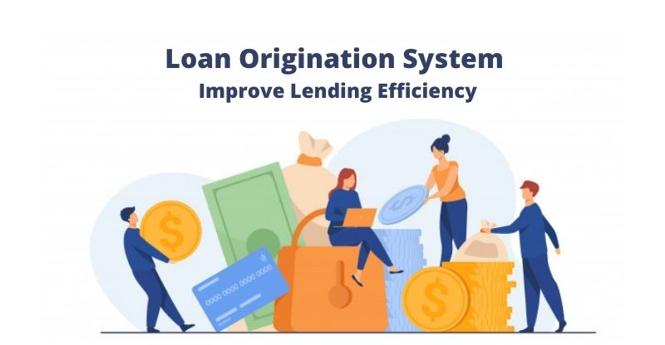
Loan Origination System
Group member:
Rajnandini Lohar
Akshay Gupta
Sandhyarani Mohapatra
Sanika Weljali
Prakash Choudhary
Shivani More

Slide 2
Contents
Introduction
Technologies Used.
Workflow
What’s New
Uses
Unique Selling point

Slide 3
Introduction
What is Loan Origination System.
Difference between Loan Origination system and Loan Management System.
Types of Loan.
-Home loan.
-Personal Loan
-Car Loan
-Education loan etc.

Slide 4
Loan can be bifurcated into two types
Secured Loan- Secured loan are less risky as bank/NBFS have collateral.
Unsecured Loan- Unsecured Loan are way to risky due absence of collateral. For this loan technology can play a part to predict customer’s ability to repay the loan using historical data, checking credit profile

Slide 5
What’s New
Education loan for Abroad Study:
JASPER Abroad study Loan
Women JASPER Abroad Study Loan

Slide 6
Eligibility Criteria:
Student Should be Indian Citizen.
Age should be less than 25 years
Application only for BPL student with zero interest rate.
Marks should be greater than 90% for any student.
Marks should be greater than 80% for Girls student.

Slide 7
Technologies Used
We would be building a website to demonstrate the Loan Origination System.
Technologies Used:
Java
JavaScript jQuery
HTML5
My-SQL
API
Spring-Boot
Bootstrap

Slide 8
Workflow of LOS:
Lead Generation
Eligibility Check
Credit Profiling
KYC details
Bank Details
Submission of Documents.
Disbursement of loan

Slide 9
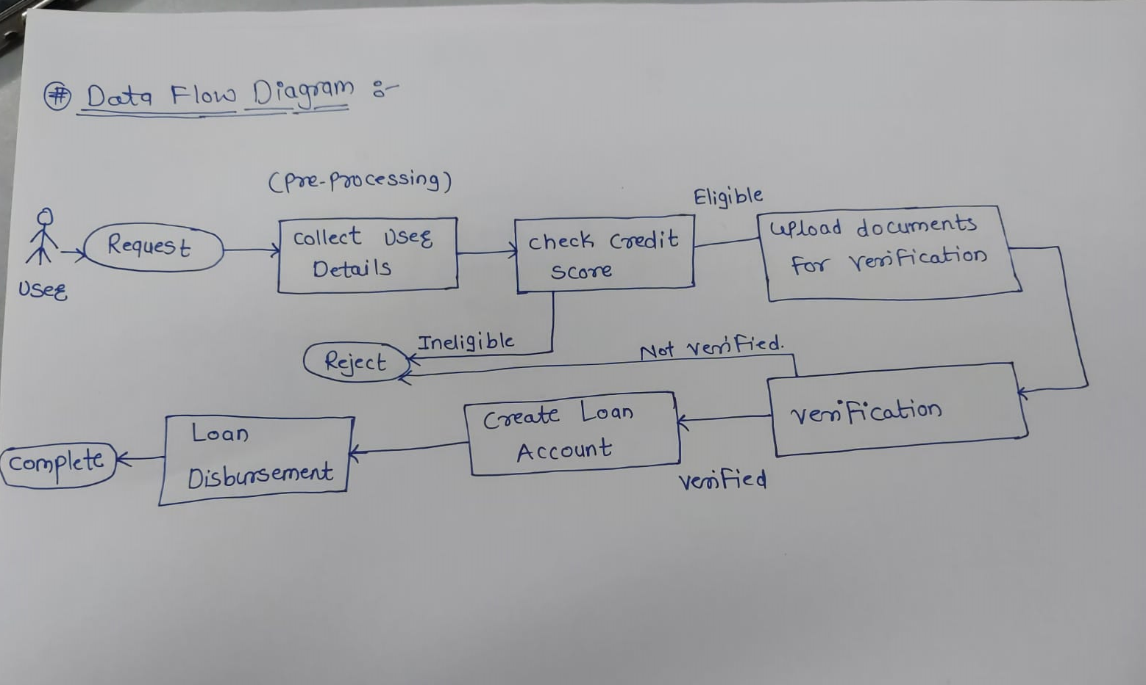

Slide 10
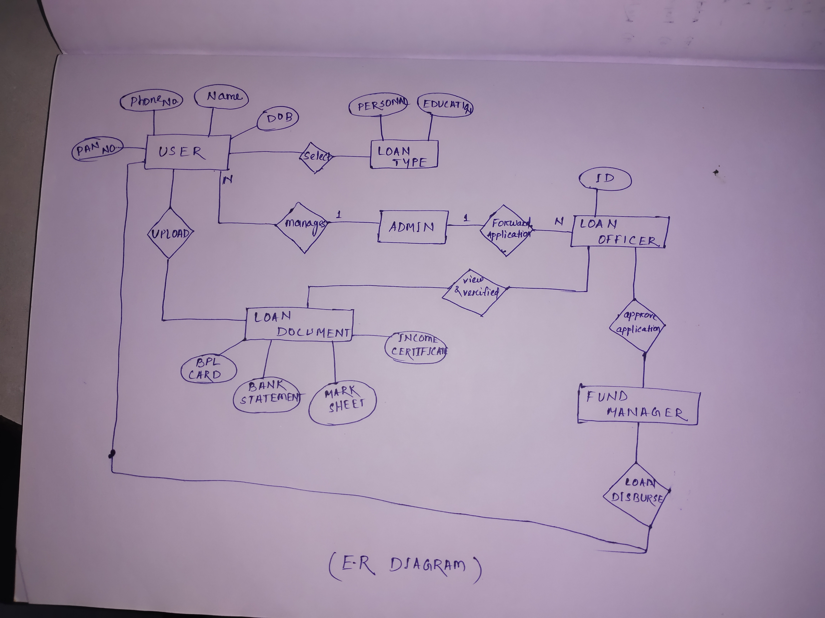

Slide 11
Benefits
Streamlines Loan Documentation.
Enables Frictionless Customer experience from very start

Slide 12
Unique Selling Point
Technology cannot only reduce the overall time of customer’s loan journey but also assist bank in projecting customer ability to repay the loan
Technology have also reduce the overall cost for granting a loan to a customer
We will leverage the technology to Disburse loan to customers in a very short span of time.

Slide 13
Thank you..

